Slide 1
HNC Computing
Developing Software: Introduction
(H173 34)
Week 9
Lecturer – Dawn Wilson

Slide 2
Testing – Program Errors
the process of executing programs with the intention of finding errors
Types of program errors:
  Syntax error - caused by the failure of the programmer to use the correct grammatical rules of the language e.g. spelling/typing mistake. Detected by compiler and build fails
  Run-time error - detected by the computer and displayed during execution of a program. Program stops running and message is displayed e.g. dividing by zero
  Logic errors/flaws - arise from faulty thinking on behalf of the programmer. Program will still execute but not output the expected results. Difficult to find as no error messages

Slide 3
Formal Testing
A Test Plan should be constructed which indicates an incremental development where each module is to be tested in turn, with appropriate test stubs. For each test, expected results should be noted.
A Test Log indicates the results of each test run, whether the test is successful or not. If a test is successful and an error has been discovered then the code should be redesigned, amending pseudocode, recoded and retested.

Slide 4
Test strategies – Top-Down
During the implementation phase, adopt a top-down approach to testing:
  Put the structure of the program in place using function stubs and test the flow of the program before proceeding
  Implement and test each function stub in turn, completing associated test logs
    Code and unit test a component i.e. iteration, selection
    Add the component to the existing combination
    Test and debug the new combination
    Until all the components have been added

Slide 5
Test as you go (top – down test strategy)
Implement the menu_driven_interface, calling ‘stubs’
Test the menu_driven_interface
Complete associated test logs
Then develop each of the stubs in turn:
Implement menu option 1 provision
Test the menu option 1
Complete associated test logs
Implement menu option 2 provision
Test the menu option 2
Complete associated test logs
MENU
(menu_driven_interface)
Username
(get_names)
Factorial
(get_number)

Slide 6
Testing Approaches – Black Box
Black box testing (Functional testing) – treats the system like a black box and does not look at the code that is being tested. Verifies that the program performs as it was requested at the specification stage
  Tester derives and/or selects test cases based on an
  analysis of the specification.
  Typically, when performing a black box test, a tester will interact with the system's user interface by providing inputs and examining outputs without knowing how the program has been implemented

Slide 7
Testing Approaches – White Box
White box testing (Structural testing) – programmer studies code being tested and executes every path.
  Guarantee that all statements in the program have been tested at least once, i.e. identify all pathways through code (e.g. sequence, selection and iteration).
  Test all the decision statements on their true and false side and check to see which of these paths have not been tested in the Black Box approach.
  Test all loops at their boundaries and their operational limits.
  Create new test data for paths not already tested.

Slide 8
Test levels
There are generally four recognized levels of tests:
  unit testing – testing individual components
  integration testing – testing interfaces between components
  system testing – end to end testing
  acceptance testing – done on-site by the customer

Slide 9
Testing
Normal conditions
  Performs as expected when used normally
Extreme conditions
  Handling of situations at the edge of what is normal i.e. look at boundary conditions
Exceptional conditions
  Handling of situations/inputs not designed to cope with

Slide 10
Functional Testing
get_names
  Validate that it correctly produces a username
    3 x normal tests
    3 x boundary tests – short names, long names, uppercase/lowercase
    3 x extreme tests – non-alpha characters, blanks
get_number
  Validate that it correctly calculates a factorial
    3 x normal tests
    3 x boundary tests – small numbers (0), large numbers
    3 x extreme – non-numeric, negative numbers, decimal numbers

Slide 11
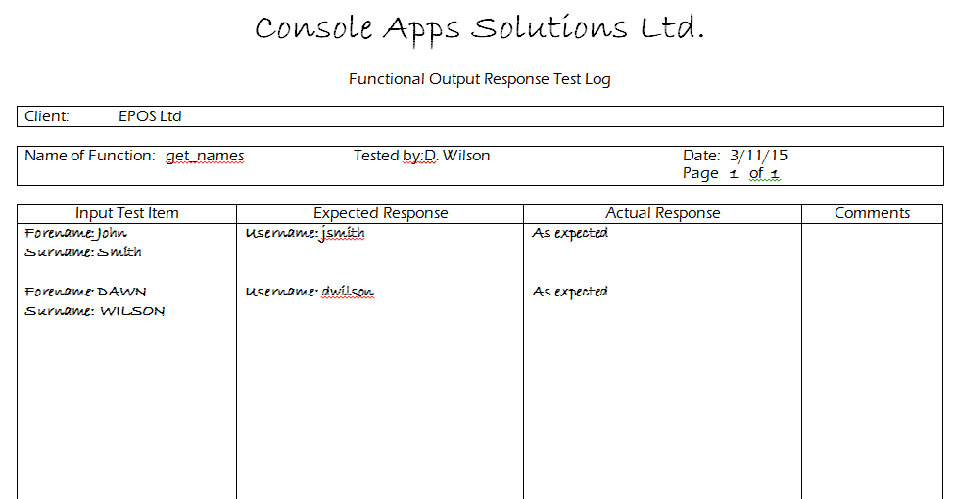
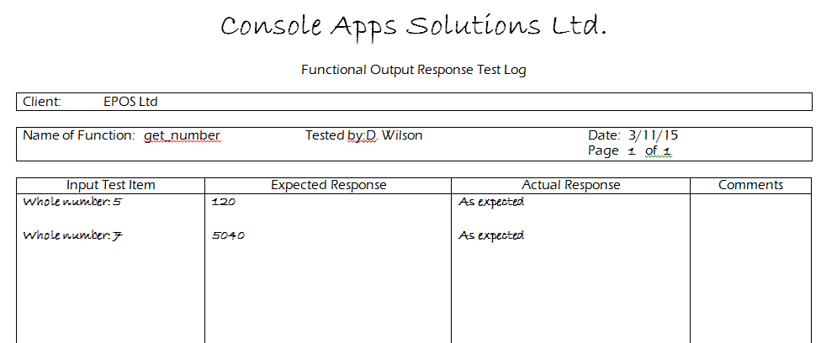

Slide 12
Input Validation Testing
get_names
  Test each input (forename, surname) separately for different user inputs N.B. no input validation for names
  forename
    3 x normal
    3 x boundary – short, long, mixture of uppercase/lowercase
    3 x extreme – blank, non-alpha
  surname
    3 x normal
    3 x boundary – short, long, mixture of uppercase/lowercase
    3 x extreme – blank, non-alpha

Slide 13
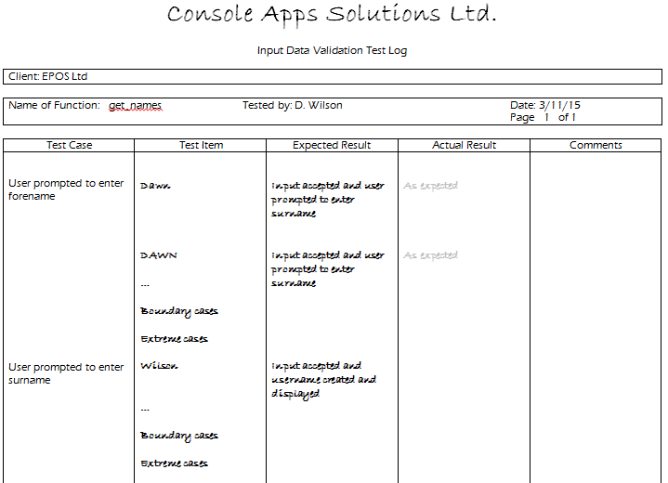
Input Validation Testing

Slide 14
Input Validation Testing
get_number
  Test the whole number input for different user inputs N.B. no input validation for whole number
  whole number
    3 x normal
    3 x boundary – small, large
    3 x extreme – blank, non-numeric, decimal, negative

Slide 15
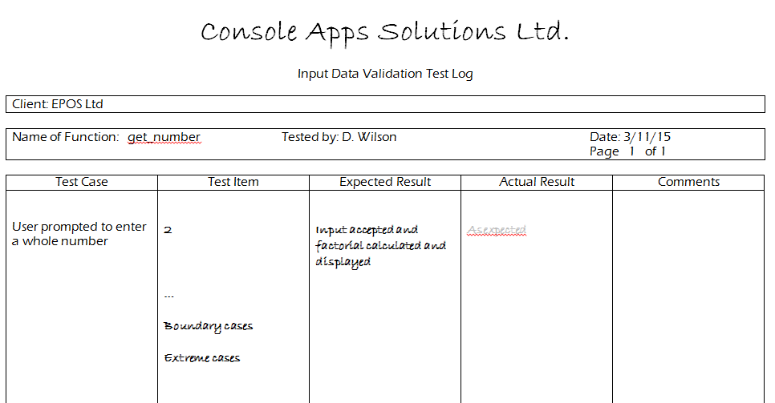

Slide 16
Input Validation Testing
menu_driven_interface
  Test the menu input for different user inputs N.B. input validation is required for menu option where input must be 1,2, or 3
  menu input
    3 x normal – 1, 2, 3
    3 x boundary – 0, large number, blank
    3 x extreme – non-numeric, decimal, negative

Slide 17
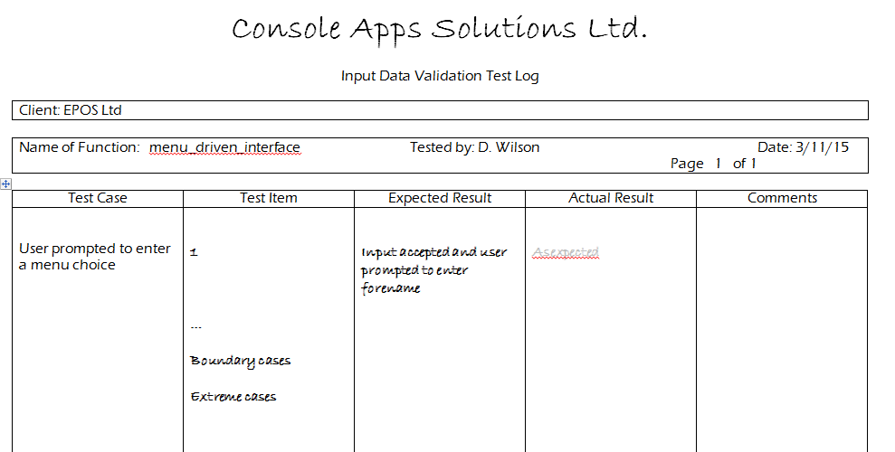
Input Validation Testing

Slide 18
Demonstrate Good Practice
Apply consistent and meaningful names to variables and functions
Well laid out code
  Consistent use of indentation
Comment code
  Short description for each function
  Provide pseudo-code for any complex algorithms

Slide 19
Technical Guide
A technical guide should be submitted, consisting of:
  Project brief
  Requirements Specification document
  Design document
  Program code listing
  Test documentation

Slide 20
Project Brief
  sets out the general requirements of a client from a system.
  It is written in non-technical terms and acts as a terms of reference for the programming project team.
  This document is used as the basis for the creation of the software requirements specification.

Slide 21
Requirements Specification Document
The software requirements specification should be agreed with clients and should be a complete statement of the functional and informational requirements of the proposed system.
The specification should be clear and unambiguous and agreed with the client before future development takes place. Since no system will be completely specified at the beginning of the project, the specification should be written in a form which allows easy amendment.
Formal specification methods and languages exist, but a flexible format would incorporate:
  Introduction: this will comprise the project brief obtained from the user, i.e: the narrative description of the proposed system.
  Information Description: this will describe the main organisation of data within the system in terms of data structures and their components.
  Functional Description: a clear description of each function of the system, noting design constraints and performance characteristics.

Slide 22
Design Document
shows the architectural design of the system, which is concerned with the overall organisation of a software system
decompose a problem into simpler sub-problems which can be handled separately. This process is called Functional Decomposition/Top-Down Design
Each of the separate software components is called a Module and the process is also known as Modular Design.

Slide 23
Resources
S:\hccomp\Dawn\HNC – Developing Software Introduction\Assessment Material
http://192.168.11.111/resource
http://softdev.hnd-computing.com

